Slide 1
Trần Công Duy Nguyên – EDA34

Slide 2



Currenty working on R2T2 tool
Notes:
Take full responsibility for developing its be and fe.
Use expressjs for be and a framework called Quasar to develop fe
- And yeh, this Quasar fw is built on VueJS – the topic of my sharing today

Slide 3

Vue introduction
The progressive framework

Slide 4
Agenda
What is Single Page Application (SPA)?
What is Vue?
The Vue instance
The component system
The rest of Vue ecosystem
Live code
Opinionated comparison
Notes:
Give you a look about SPA bc it’ll help you understand the mission of VueJS
Then we start digging deeper to the fw with …
Next, give you a more practical view of how everything basically works
The last will be the most interesting part -> the comparison between Vue,React, Angular. Stay tuned!

Slide 5
What is Single Page Application?
The revolution of SPA
Notes:
So, how the SPA has evolved

Slide 6







The ‘old’ way
Client side
Multiple Page Application
Request
Response
Server side
Presentational Layer
  Big payload (compare to SPA)
  Browser refreshing
  Duplicated content
Controller
Views
  Coupling
Service Layer
Business Layer
  Heavy transactions
  Jarring, bad UX
  Bad practice
  Slowdown the development
Data Layer
Data
Source
Notes:
This pic shows you how a traditional website work, we have a backend app which returns HTML page whenever client sends request
The server will handle the client request and generate HTML page within Presentational Layer
With this architecture, we’ll have some drawback such as…

Slide 7


The revolution of AJAX (Asynchronous JavaScript and XML)
XMLHttpRequest (XHR) API
Update
+
Notes:
With browser started supporting XHR API and the power of JS => the UI on the browser can be updated partially and asynchronously
This technique called AJAX and it will move the responsibility of processing UI from server side to client side

Slide 8

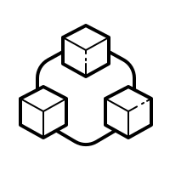

The ‘SPA’ way
Client side
Views
Single Page Application
AJAX
Presentation logic
  Presentation logic
  is handled at frontend
Server side
JSON, XML…
  Single HTML initialize only once
  Dynamically & asynchronously updating DOM
  Communicating via
  JSON data
Controller
JSON, XML…
Service Layer
Business Layer
  Decouple development process
  Lighter payload for later transactions
  Without Browser refreshing
  Increase
  codebase reusability
Data Layer
Data
Source
Notes:
And this is the model of a SPA, in the first request the client side will receive all the script it need to have to implement the render process
After that, any followed request will dedicate to receive the data or the state of the UI and let the client do the rest of the work
This architecture will give us many benefits…

Slide 9







SPA is very popular
Give better UX for end users
Beneficial to PWA and mobile development
Easier for developers
Notes:
The SPA technique has been broadly using in the world, many big applications have successfully implemented it like…
And the advantage is really obvious…
And yes, that’s how great the SPA is. Next step, we will see how Vue makes a SPA

Slide 10
What is Vue?
Brief history
Design philosophy
Preparation
Notes:
We will have 4 main part in this section

Slide 11



Brief history
Vue in French
=
View in English
Evan You
First commit was on July 2013
Notes:
So this guy is Evan You, the father of Vue. He is an ex-google developer and worked at Google Creative Labs
Vue is French word and it means view in English
Vue was inspired by Angular JS which also called Angular 1
And his first commit of this project was on July 2013

Slide 12
Design philosophy
Declarative
Rendering
Component
System
Client-side
Routing
State
Management
Build
System
Notes:
The design philosophy basically means the idea of the framework
Regarding that, the Vue idea is progressiveness. Let’s me explain you what it means:
when developing web you can go from a small, simple app with just some simple widget to a complicated app like commercial or enterprise app; and Vue will provide you the proper tool for each stage.
For ex, if you just build a simple page without navigation or you just embedded a part of your UI with Vue, you just need a vue-core library which supporting declarative rendering…

Slide 13

The declarative rendering
State
Rendered UI
Vue core
Declarative
How the state should be on the UI
Imperative
What are the step to transform the state to the UI
data: { text: ‘Hello World’ }
<div id=‘demo’> {{text}} </div>
const newElement = document.getElementById(‘demo’)
newElement.textContent = ‘Hello World’
Notes:
Next, we will explore the first layer of the fw
So what is declarative rendering? Let’s see the picture, Vue core acts as a machine which will process the state to generate the UI for us.
In other word, we will define how Vue will generate the UI from the state or the data
It’s really different from the imperative style which we tell our code what steps to create the UI
You can find the imperative in the famous fw call Jquery, or when you make web frontend without any fw

Slide 14
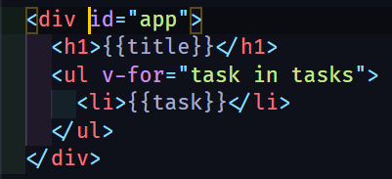
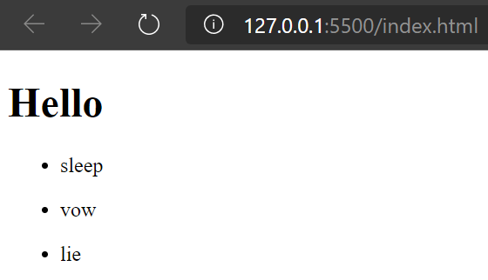
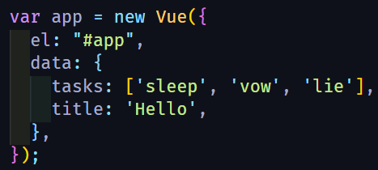
Interpolate template
Hook up
Vue instance
Notes:
We can look at the ex: We define the Vue instance then hook it to our markup.
Vue will help us do the rest of work by rendering the markup.
Ok, it’s the first and basic layer of Vue

Slide 15
Preparation
Content Delivery Network (CDN):
<script src="https://cdn.jsdelivr.net/npm/vue/dist/vue.js"></script> (development)
<script src="https://cdn.jsdelivr.net/npm/vue"></script> (production)
vue-cli:
vue create <project name> or vue ui
Vscode extension: Vetur
Vue core
Notes:
Now let see what you’ll need to implement the vue-core..
- The quickest: CDN
Experience SFC
Improve syntax highlight
That’s it, now you can create an Vue app :D

Slide 16
The Vue instance
Architect pattern
Vue options
Vue directives
Instance lifecycle
Notes:
Ok, now we’re going to see the heart of Vue – the vue instance
Why I call that a heart of vue, because we need Vue instance to bind the UI and our presentation logic

Slide 17
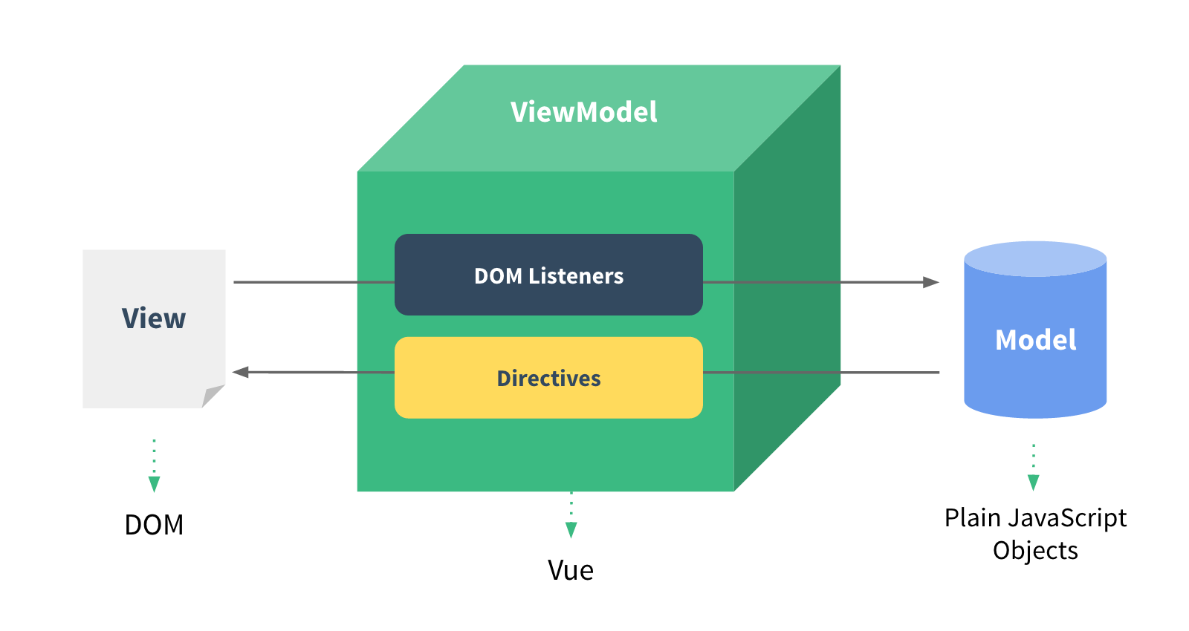
Architecture pattern
Notes:
First, we will look through the architecture pattern, which concrete and inspire Vue
This architecture partly alike MVVM pattern.
While the vue instance play a ViewModel role, our DOM and our Data act as View and Model respectively
And with this pattern, Vue instance will help us to build up our UI base on the data or the state from our backend

Slide 18
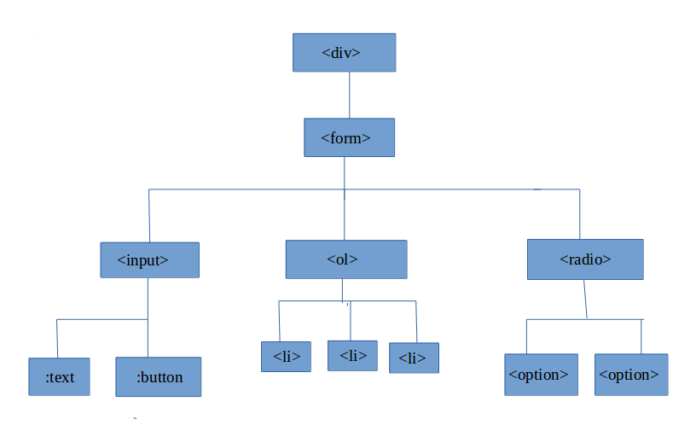
The vue instance
Life cycle
beforeCreate
beforeUpdate
created
updated
HTML Tree
beforeMount
beforeDestroy
mounted
destroyed
Vue instance
Vue directives
{Options}
#el
computed
template
data
methods
Notes:
So this is how the Vue instance really look like, it comprises of 3 main part:
The options: define the behavior
Vue directives: Help vue instance interacs with the DOM or the UI
The last is the life cycle functions

Slide 19
Vue options
Notes:
Firstly, the Vue options

Slide 20
#el, template, data
HTML
#el: Mount Vue instance with DOM element
via CSS selector
template: Define HTML markup for Vue instance
within a string
data: A data object or a function return object for Vue component, it’s reactive
Notes:
Vue options programmatically are the properties of the object which we pass into the Vue instance constructor
These options will define the behavior of Vue instance, let’s look through some…
With these three, we can define how the vue instance render the UI

Slide 21
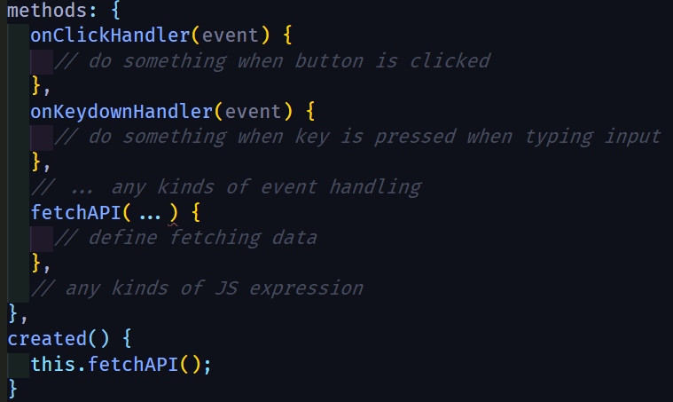
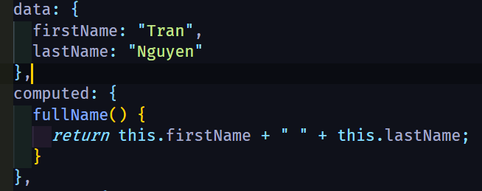
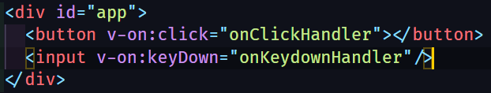
Method, computed
views
data
?
computed
events
methods
Notes:
There’re also 2 more options I want to introduce, that is: method and computed
Now we know how to define the UI state via the data option. Beside that, vue has methods option which let you define the function or the handler for the state inside vue instance
Computed is likely the getter in JS object, it will accumulate the data and return the result
So how does these options really bind with the UI?

Slide 22
Vue directives
Notes:
It relates on the Vue directives.

Slide 23
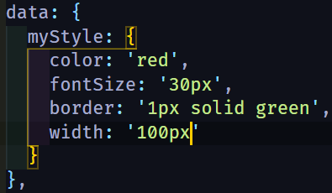



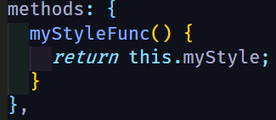
Data binding
data
Template element’s attributes
props
computed
methods
v-bind
…
bind
bind
Notes:
Vue directives are the special tokens provided by vue to do something to the DOM
And firstly, we have v-bind which handle data binding for Vue.
It will bind the data to the DOM attribute

Slide 24



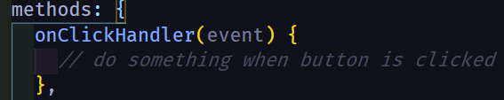
Event handling
v-on
methods
bind

Slide 25
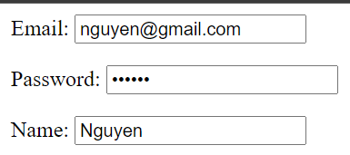
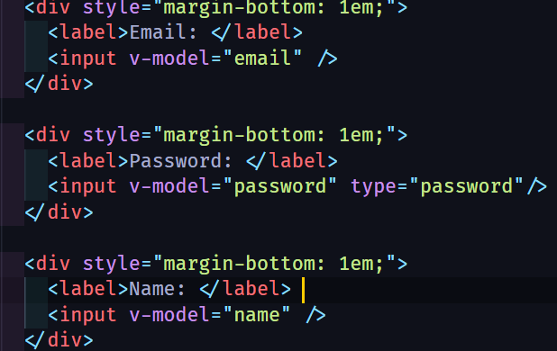
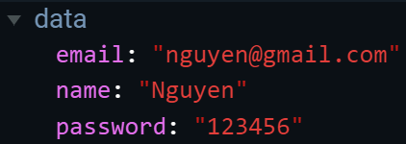
Form input binding
v-on:input
v-model
Input value
v-bind:value
v-model

Slide 26
Notes
v-on, v-bind shortcut
v-on:click
@click
v-bind:style
:style
specifier
<directiveName>:<argument>.<specifier> = "<expression>"
Ex:
v-on:click.keyup
v-model.lazy
Specifier indicates the directive should be bound in special way

Slide 27
Conditional rendering
v-if = “conditional expression”
v-else-if = “conditional expression”
v-else
v-show = “conditional expression”
Toggle CSS property display
Toggle real rendering process

Slide 28
List rendering
v-for = “(value, key, index) in object”
v-for = “(item, index) in array”
<ul v-for = “(item, index) in array” :key=“item.uniqueId”>
// below block of code will have access to item, index
<li>
…
</li>
</ul>

Slide 29
Instance lifecycle

Slide 30
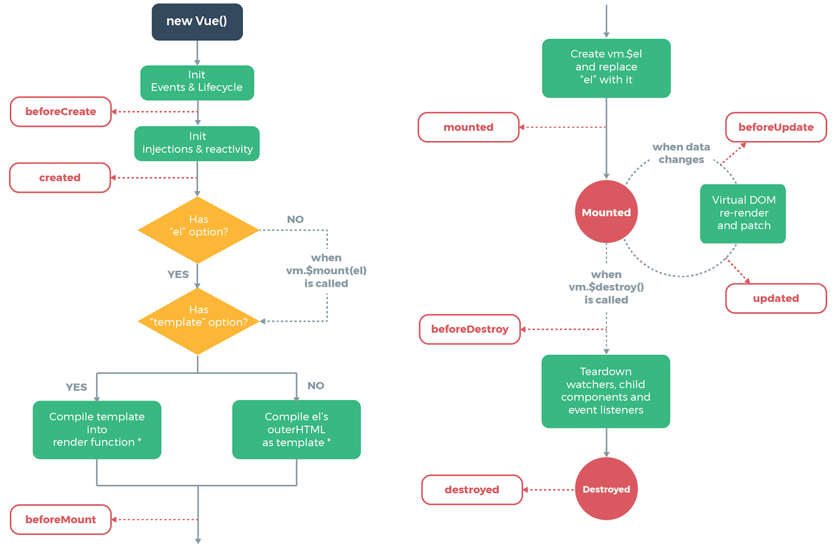

Slide 31
Vue component system
Vue component
Component communication
Single File Component

Slide 32
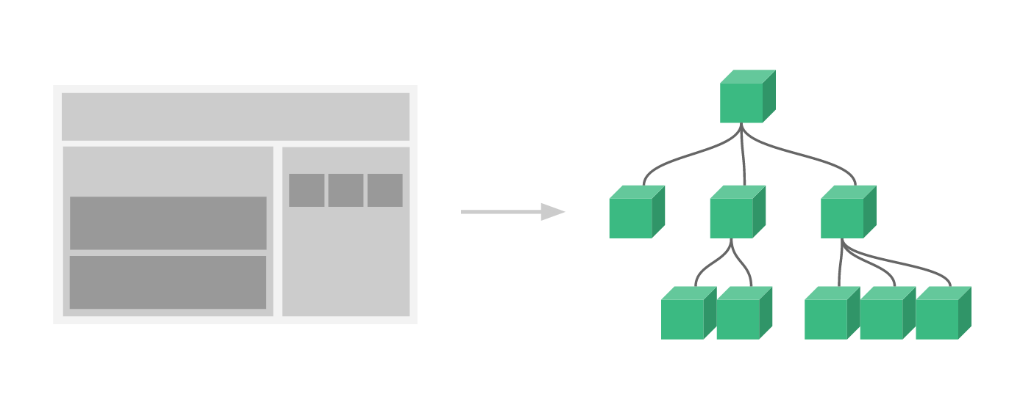
App root
App root
Header
Body
C
D
E
A
Header
Body
Drawer
Drawer
B
A
B
C
D
E

Slide 33
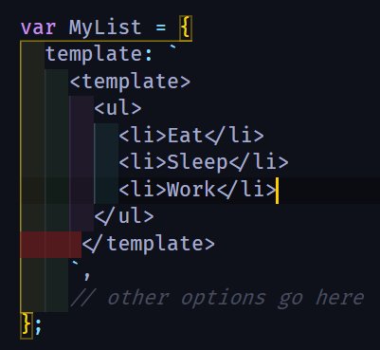

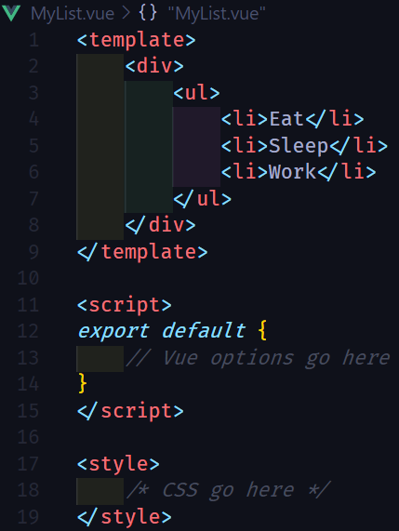


Component creation
Component registration
Literal Template
Local
Global
Usage
Single File Component

Slide 34
Components communication
Parent
Emit
Events
Pass Props
Child

Slide 35
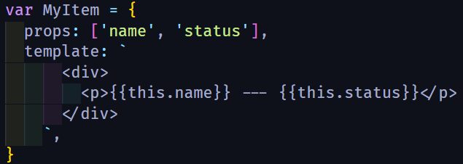
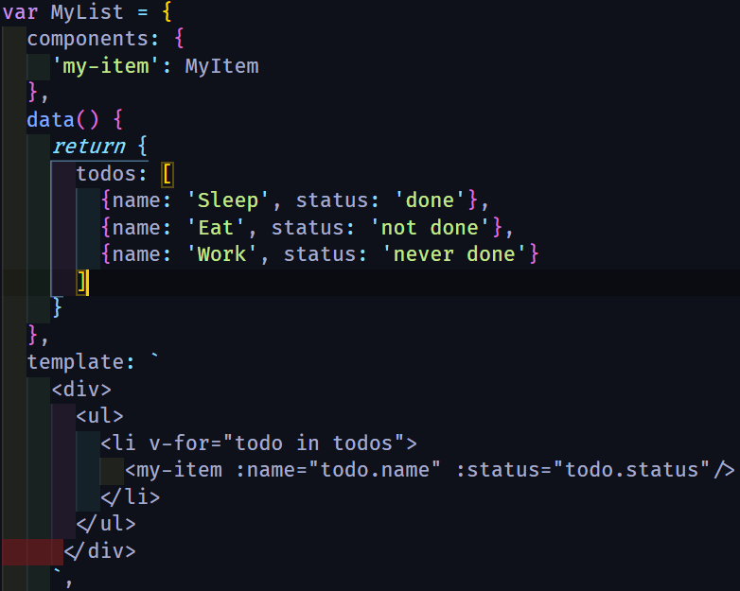
1. Define props inside child component
2. Pass data from parent to child
Parent
Pass Props
Child

Slide 36

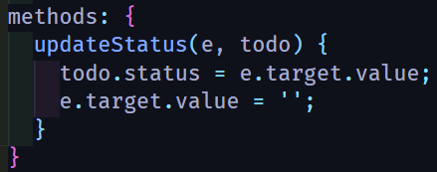
1. Define child component event
Parent
Child event name
2. Listen to child event
Emit
Events
Child

Slide 37
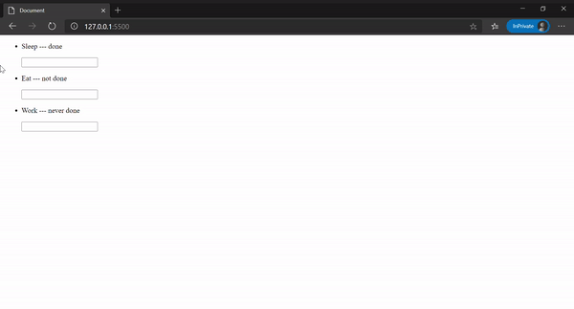

Slide 38
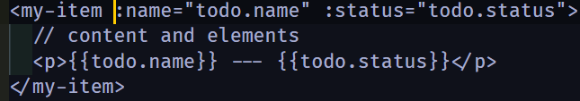
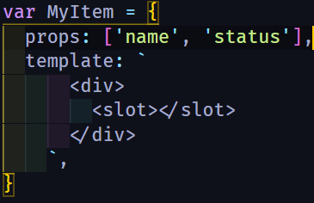
Slot element
How to pass content inside component tags ?
Slots can be separated by slot name
Parent can access child’s data via slot-scoped
Create generic component
Reduce the use of props

Slide 39
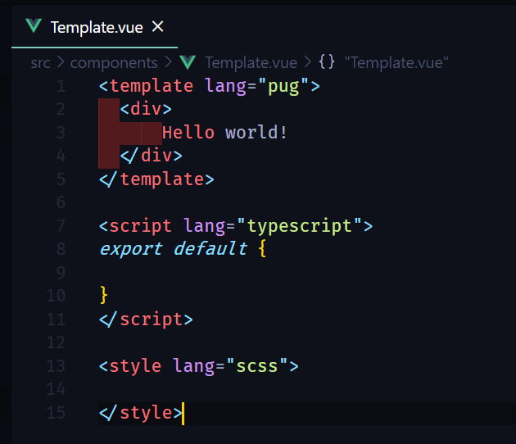

Single File Component (SFC)
Better syntax highlight
CommonJS modules
Codebase is more modularized
Component-scoped CSS
Project configuration is supported by Vue-CLI
Corporated with build system

Slide 40
The rest of Vue ecosystem
Vue router
Vuex
Build system: Vue CLI + vue-loader
Rendering process

Slide 41
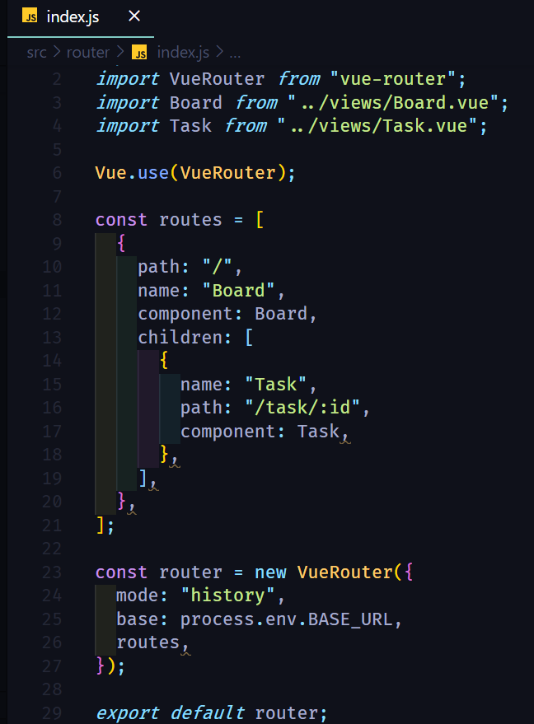
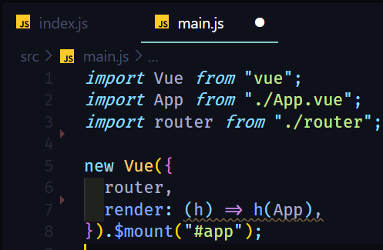
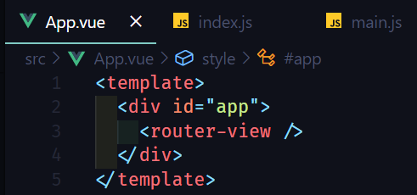
Vue router

Slide 42
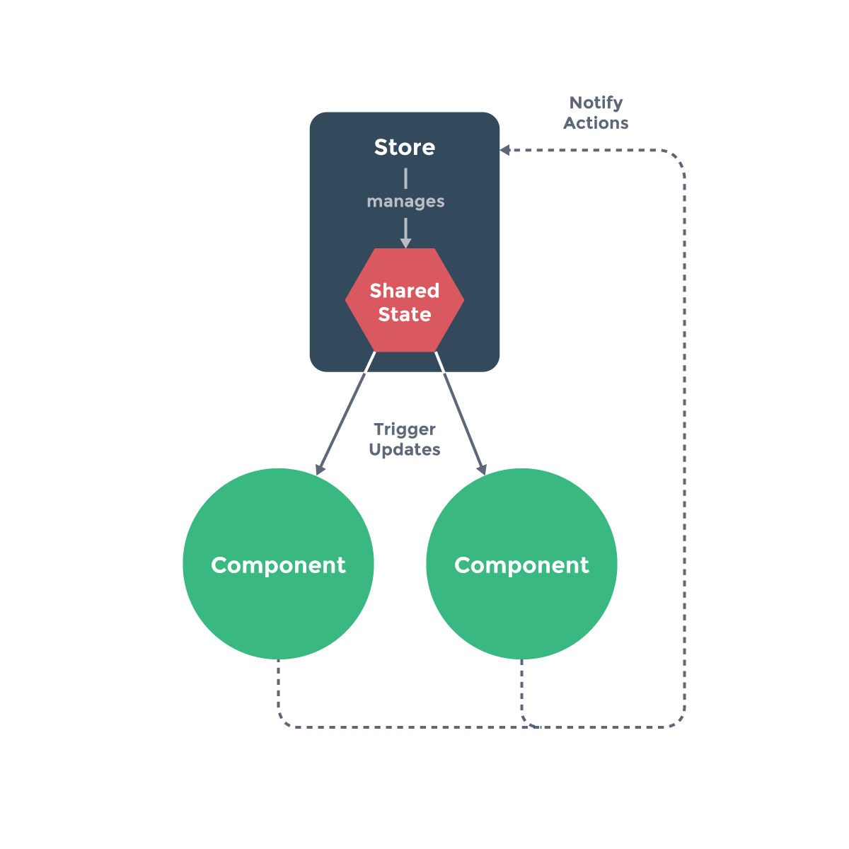
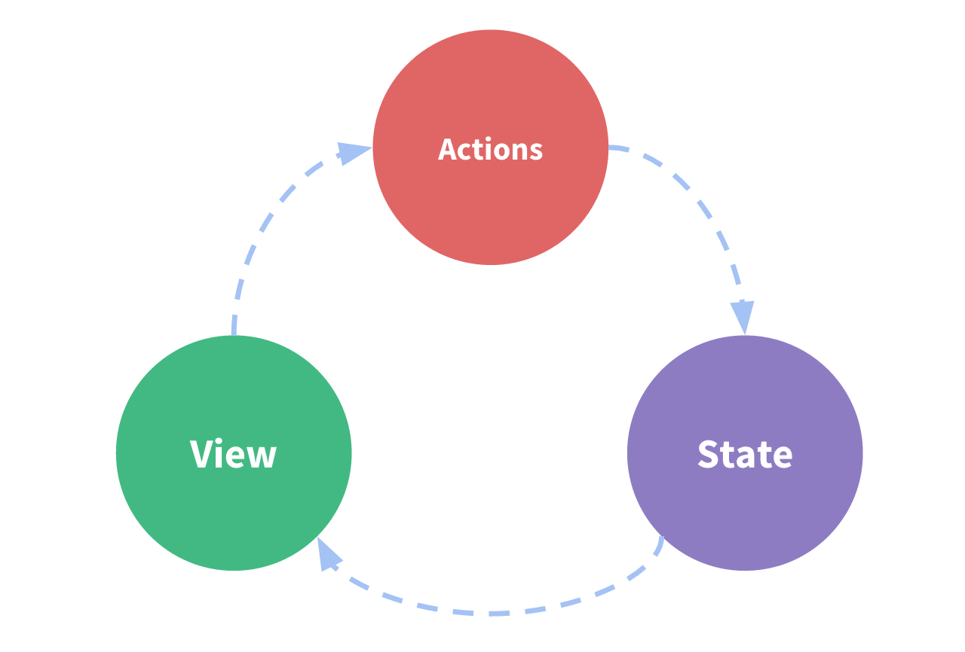
Vuex

Slide 43
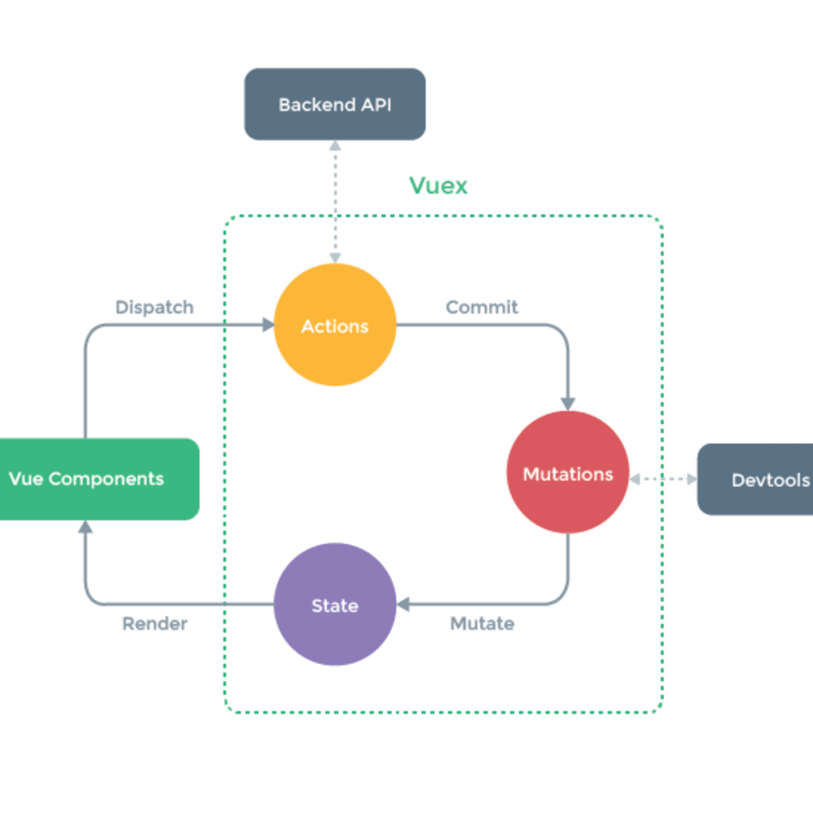
Vuex

Slide 44
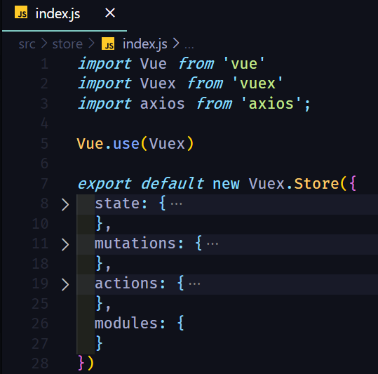
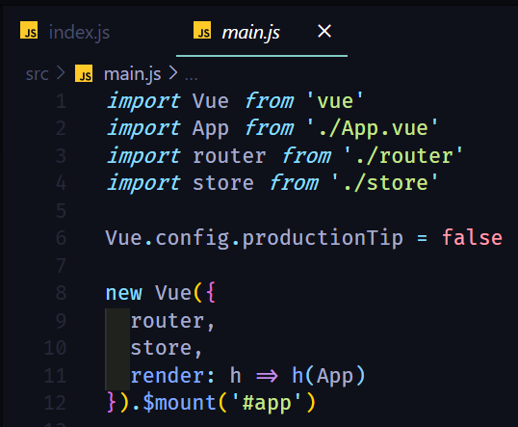
Vuex

Slide 45
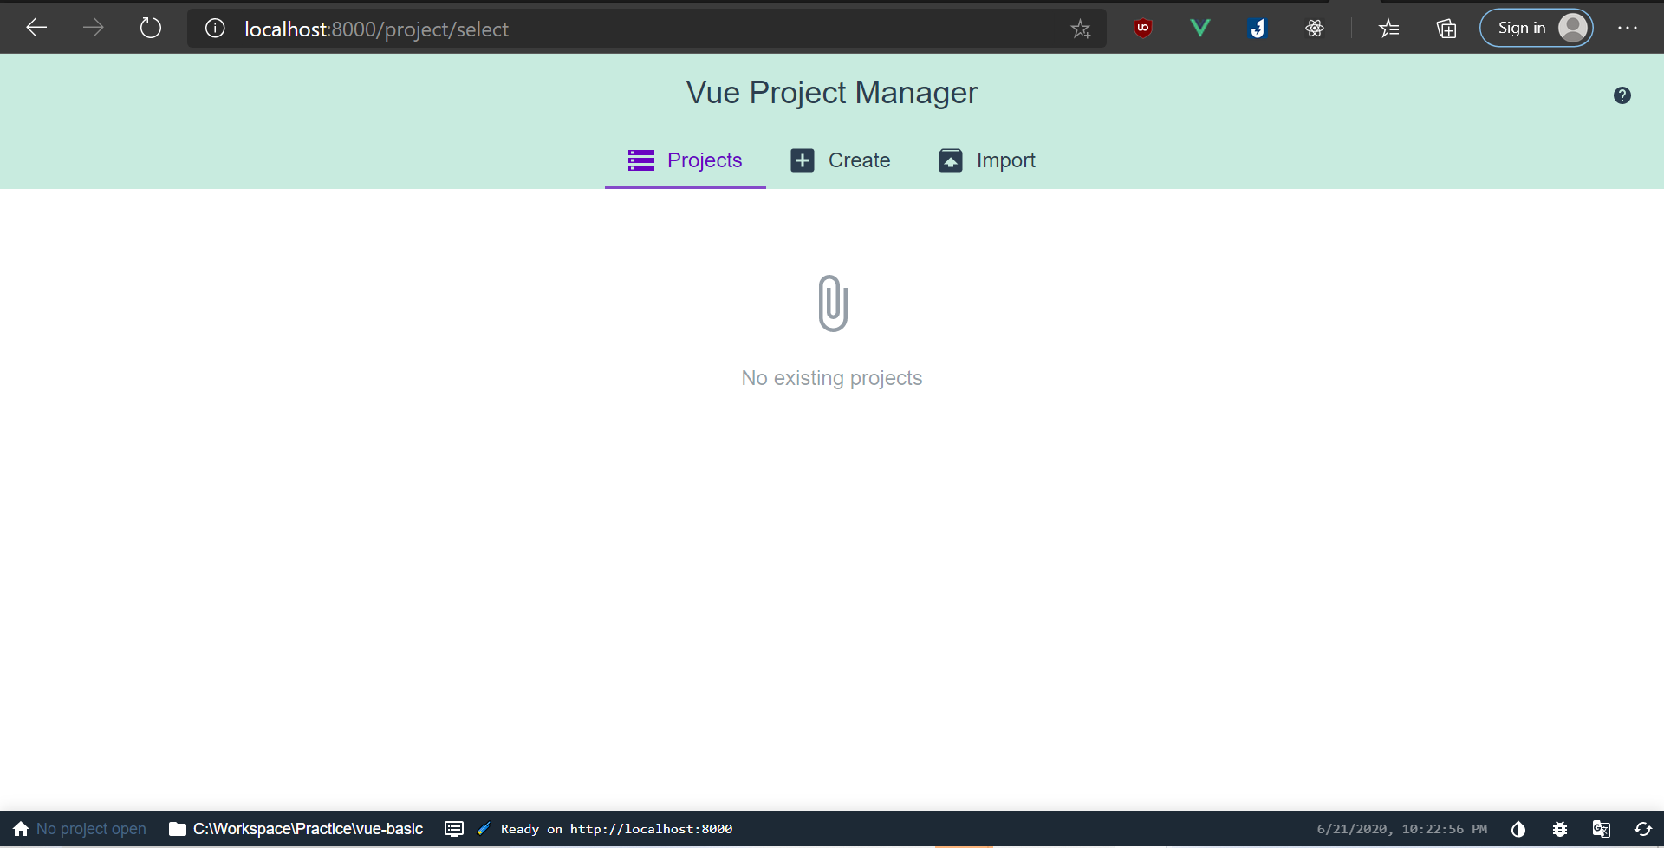
Vue CLI
CLI
CLI Service
CLI plugins
vue create <project_name>
vue serve
vue build
vue add
vue ui

Slide 46
vue-loader and vue-template-compiler
vue-template-compiler: Compiles Vue template into render functions
vue-loader: A webpack loader which helps user author SFC

Slide 47

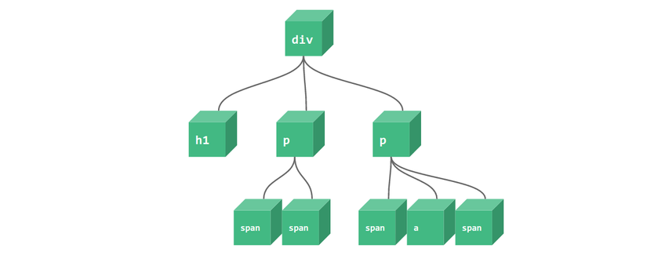
Vue rendering process
Vue Template
Render functions
VNodes
Real DOM
Virtual DOM
Pre-built

Slide 48
Live coding

Slide 49
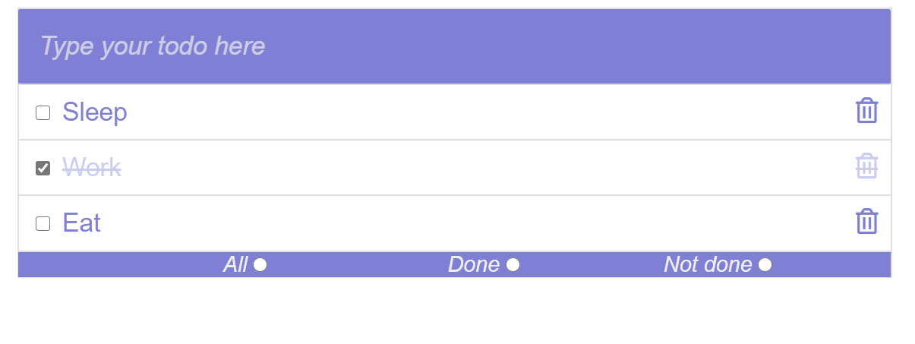
Todo app

Slide 50
Opinionated comparison

Slide 51
Compare with ReactJS
 | Vue | ReactJS
Reactive mechanism | Be specific on component | Use PureComponent to prevent re-render entire subtree components
Developing style | Easier for HTML-er | Easier for Javascript-er
Corporate libraries | Companion libraries like vue-router, vuex are officially supported by core team | React leaves these concern for community
Learning path | Easier for traditional web developer | Need to learn JSX and build systems

Slide 52
Comparison with Angular 2
 | Vue | Angular 2
Typescript based | No | Yes
Size | Smaller | Larger
Flexible | More | Less
Learning path | … | Steeper

Slide 53
The end!

